Slide 1

ATM Asynchronous Transfer Mode at the Data Link Layer
By : Raghav Panthi

Slide 2
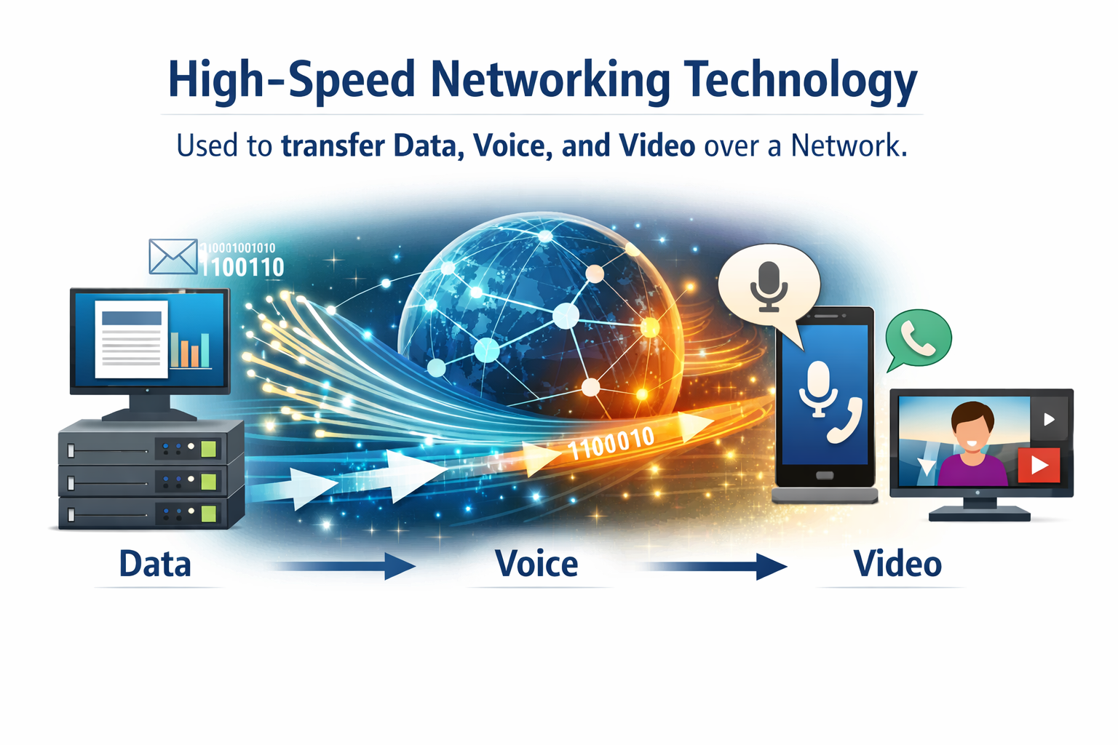
ATM's Core Function at Layer 2
ATM stands for Asynchronous Transfer Mode.
It is a high-speed networking technology used
to transfer data, voice, and video over a network.

Slide 3
Role of Atm
1
2
Framing
Error Detection
Organizing data into distinct frames (cells) for transmission.
transmission errors are find out .
3
4
Flow Control
Reliable Transfer
Managing data transmission rates between devices to prevent overflow.
Ensuring accurate and ordered data delivery between connected devices.
ATM excels in these responsibilities by systematically breaking down data into small, manageable, fixed-size units known as "cells."

Slide 4
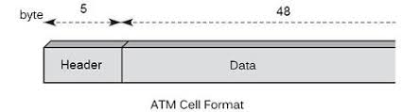
ATM Structure
Central to ATM is its cell-based architecture Each ATM cell consists of 53 bytes, divided into two main parts:
Header
Payload (Data)
5 bytes
48 bytes
Contains addressing and control information(error checking bit).
Carries the actual user data.

Slide 5

Why the Fixed Cell Size?
Faster Processing
Low Delay
Converged Traffic
Predictable cell size allows for streamlined hardware processing.
Reduces latency, making it ideal for real-time applications.
Optimized for integrating voice, video, and data efficiently.
This design choice is critical for ATM's ability to handle diverse traffic types with consistent performance.

Slide 6

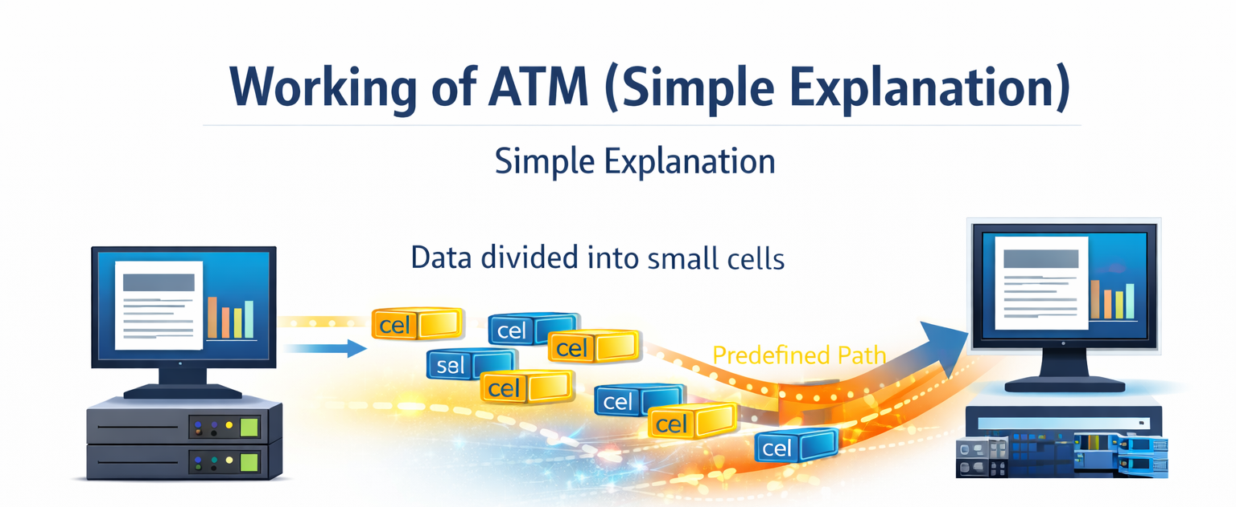



Working of ATM
Large data is divided into small cells (53 bytes)
Each cell is sent through a predefined path.
Virtual circuit.
Photo ,video
Cells traverse the network sequentially
At the destination, cells are precisely reassembled into their original data streams.

Slide 7
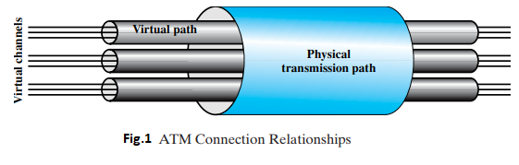
ATM _ Virtual Circuits
ATM uses connection-oriented communication
A fixed path is created before data transmission starts.
This fixed path is called a Virtual Circuit.
Virtual Path (VP):
A group of Virtual Channels
Acts like a main road for frame.
Virtual Channel (VC):
The actual path used by ATM cells
Carries one stream of data
one channels has only one type of data either (voice, video, or text)
Acts like a car/buses etc to transfer data
➡ Once VP and VC are established, data flows continuously, quickly, and in order.

Slide 8




Key Features of ATM at Data Link Layer
Fixed Cell Size
Connection-Oriented
Standardized 53-byte cells ensure consistent performance.
Establishes a virtual circuit before data transmission begins.
High Speed
Supports QoS ( Quality of Service)
Designed for high-bandwidth broadband networks.
Allows for differentiated service and prioritization of various traffic types.

Slide 9

9. Applications of ATM
ATM was used in:
1. Telephone Networks
📞 Used for: Voice calls
audio data
2. Broadband Services
🌐 Used for: Internet access
Text data ,Image data
Video Conferencing
🎥 Used for: Online meetings and video calls
4. Early Internet Backbone Networks
🌍 Used for: Main internet connections between
countries
Multimedia (text, audio, video, images).

Slide 10






